Slide 1
SWE30003 Software Architectures and Design
Lecture 4 The Role of Abstraction in Software

Slide 2
Logistical matters
Weekly submissions – A & Q
Week 2: 104 & 101 out of 119;
Week 3: 101 & 98 out of 118;
Week 4: 102 & 101 out of 118;
Week 5:
Note that this is a hurdle requirement
No late submission
Assignment 1: should be well on the way …

Slide 3
Question to Answer from Week 3
Why can quality attributes, in general, not be considered in isolation? Give two examples of quality attributes that impact other quality attributes for a system under consideration.

Slide 4

Outline
Abstractions
What is an abstraction?
Abstractions in Software
Abstractions beyond code
Domain Models
Patterns and Architectures
Questions for Consideration

Slide 5
Principal References
Len Bass, Paul Clements, and Rick Kazman, Software Architecture in Practice (4rd or 3rd Edition), Addison-Wesley, 2021, Chapter 1
Guy Steele, Growing a Language, Higher-Order and Symbolic Computation, Number 12, 1999 (available from Canvas)

Slide 6
Complexity in Software Systems
“It is not possible to remove the inherent complexity of large-scale software systems, but it is possible to use adequate development techniques to master complexity!”
— Anonymous
Moving towards solution of the problem … Analysis & Design

Slide 7
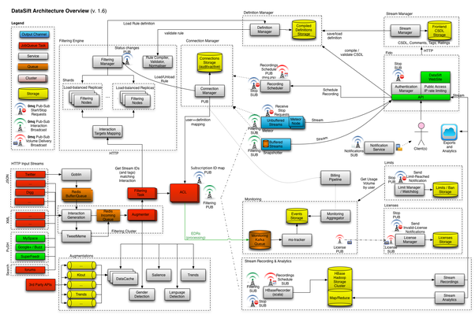

Slide 8
Design vs. Design
“Design is the creative process of transforming the problem into a solution. The description of the solution is also called the design.”
— Shari Lawrence Pfleeger, 1998
“The design of a system determines a set of components and inter-component interfaces that satisfy a specified set of requirements.”
— DeMarco, 1982
Activity & Artefact
Artefact
Notes:
Design as an activity (process) vs. design as an end-result of this activity (artefact)

Slide 9
Design (cont.)
‘‘A design is a plan how to build a thing. To design is to build a thing in one’s mind but not yet in the real world — or, better yet, to plan how the real thing can be built.’’
— Guy Steele, OOPSLA 1998

Slide 10
Software Design Methods
Many design methods have been defined:
Modular:
focus on functions and procedures
Data-oriented:
focus on external data sources
Event-oriented:
how events change states
Middle-out:
Jackson System Development (JSD)
Object-oriented:
identify classes of objects and their inter-relationships
Process-oriented:
focus on communication between independent processing entities
… abstractions
Notes:
Common to all methods: offer support for abstraction.

Slide 11
Common to all software design methods: support for - abstraction,
decomposition & composition!

Slide 12
Abstraction
A concept or idea not associated with any specific instance,
Leaving out irrelevant detail, highlighting important elements,
Mathematically, an abstraction is a mapping.

Slide 13
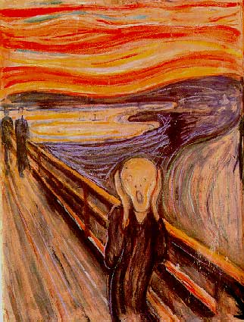
Abstraction - Example
Notes:
The Scream by Edvard Munch (1893), which inspired 20th-century Expressionists
What does this picture try to tell us? Either way, it communicates using abstract concepts (typical for expressionists)

Slide 14

Abstraction - Example (cont.)
Notes:
Although this looks like a real image, it is actually a computer-generated picture!

Slide 15
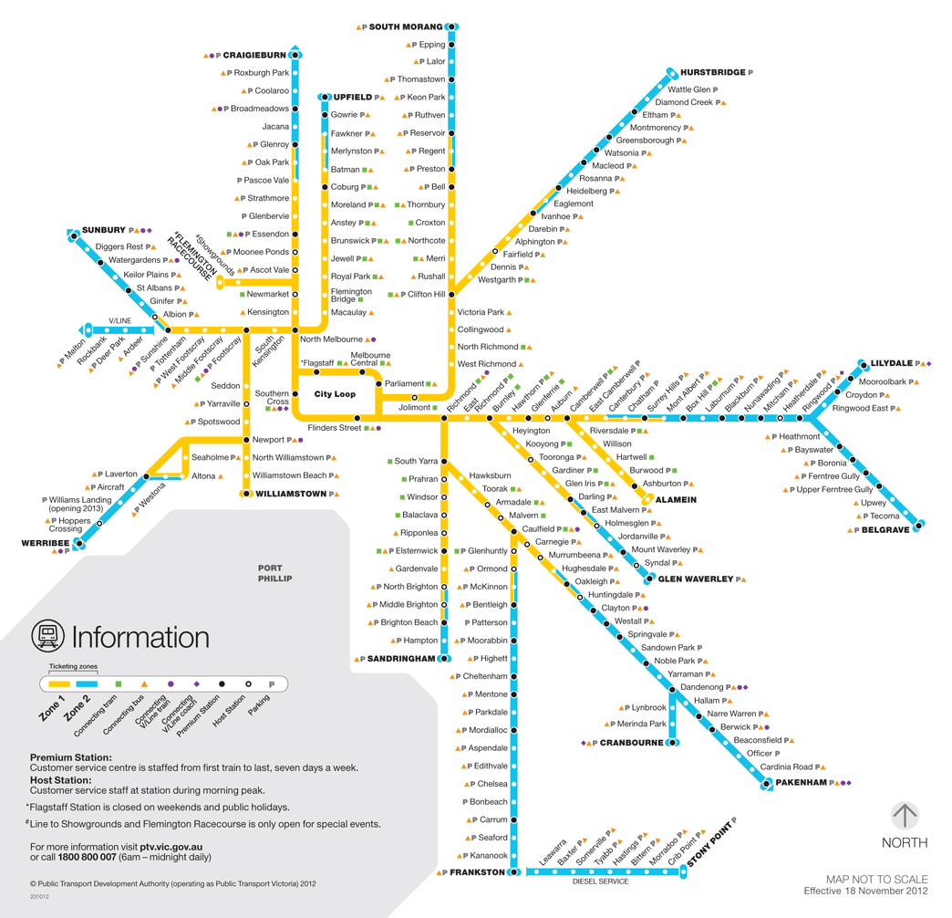
Abstraction - Example (cont.)
Notes:
Maps (of any shape or form) are good examples of abstractions!

Slide 16
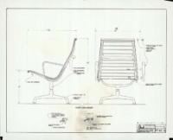
Abstraction - Example (cont.)

Slide 17
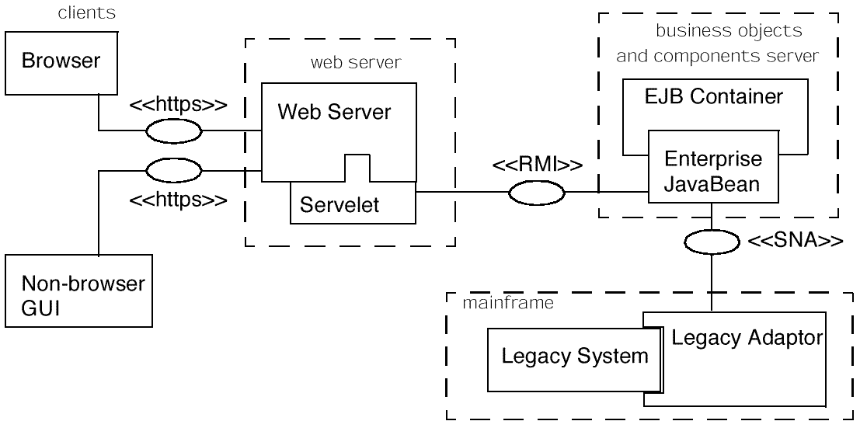
Abstraction - Example (cont.)
4-Tier Architecture
Notes:
An “abstract” view of how a distributed system is organized.

Slide 18
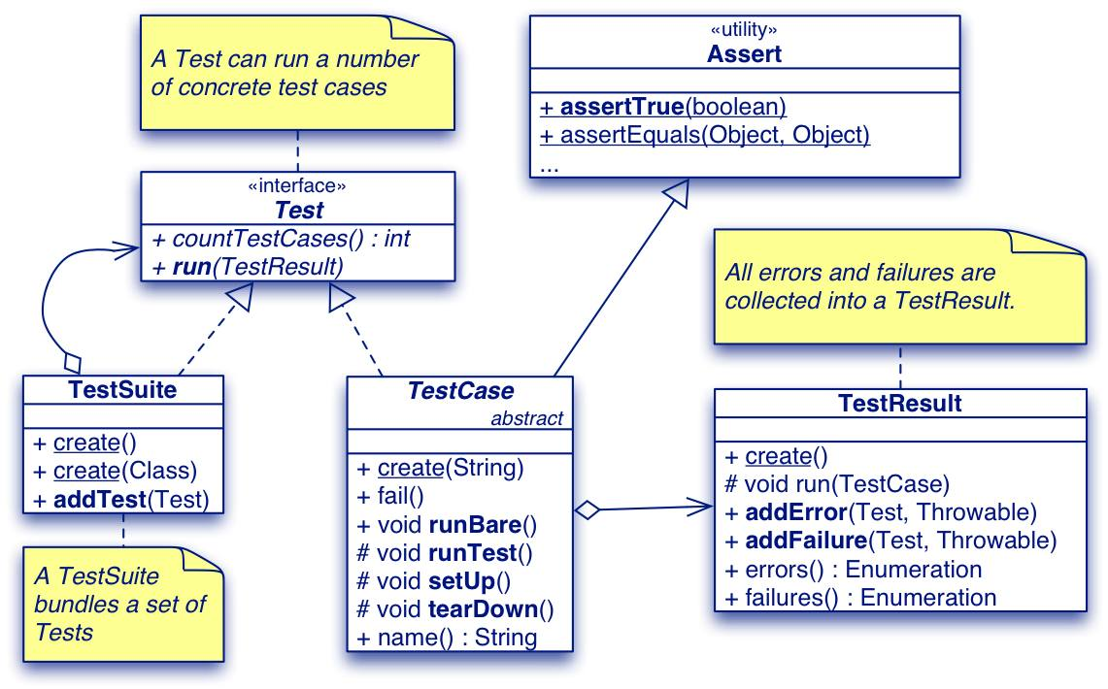
Abstraction - Example (cont.)

Slide 19
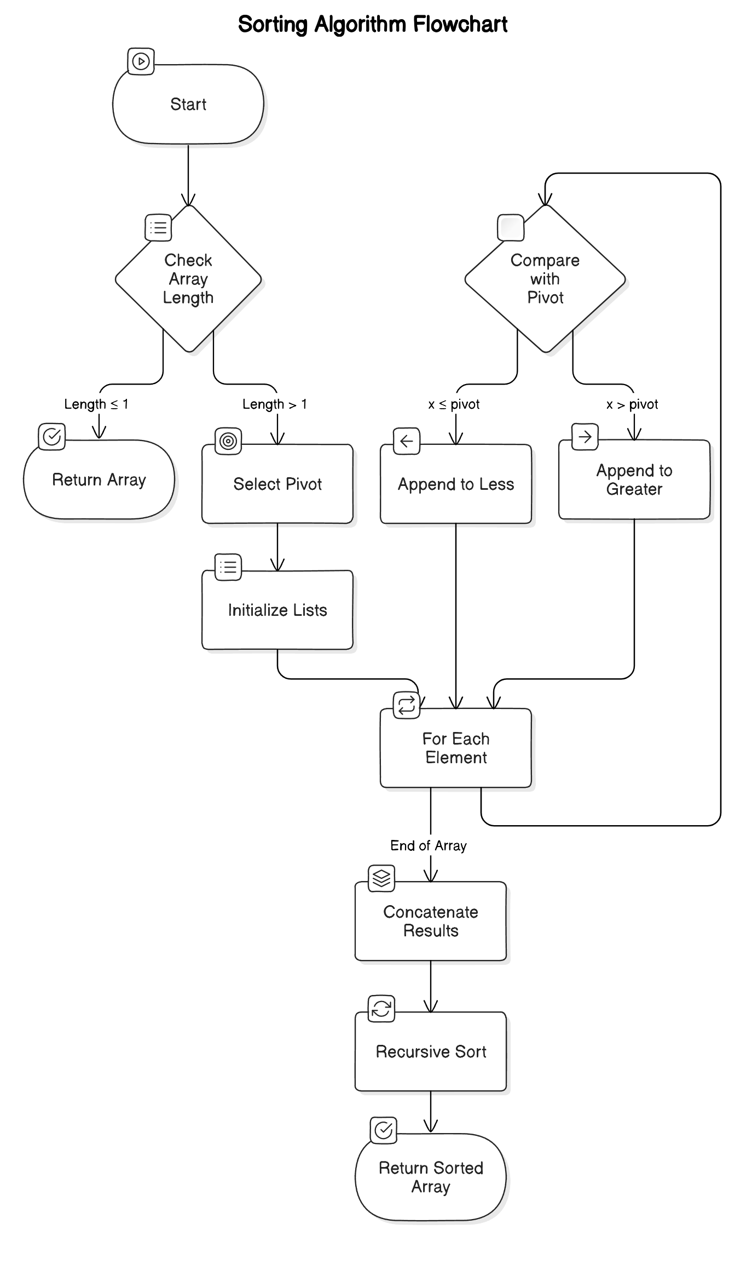
Abstraction - Example (cont.)
function sort(array)
var list less, greater
if length(array) ≤ 1
return array
for each x in array
if x ≤ pivot then append x to less
else append x to greater
return concatenate(sort(less), pivot, sort(greater))
Notes:
A functional abstraction - Quicksort (in some arbitrary pseudocode)

Slide 20
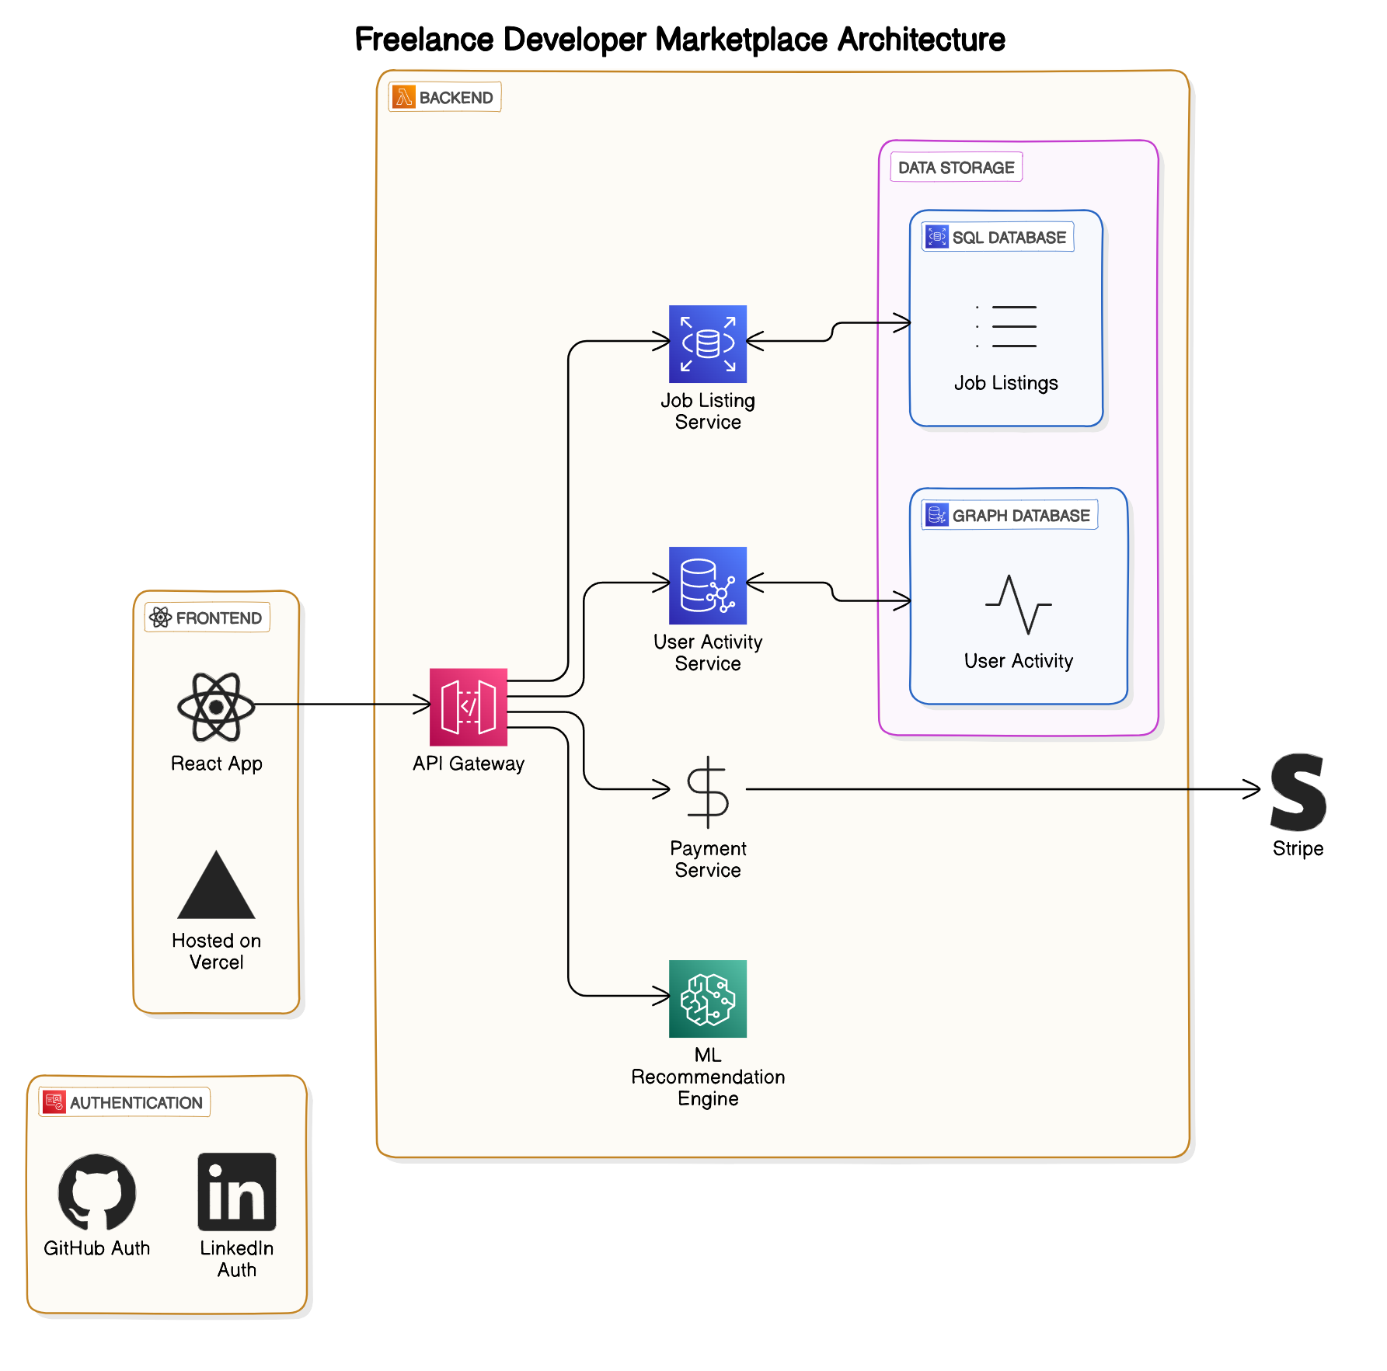

Slide 21
Abstraction - Example (cont.)
deferred class STACK [G]
feature -- Element change
push (v : G) is -- Push v onto top
deferred
ensure
item_pushed: top = v
size_increased: size = old size + 1
end;
pop is -- Remove top
deferred
require
not_empty: size > 0
ensure
item_removed: size = old size - 1
end;
top : G is -- Get top element
deferred
require
not_empty: size > 0
ensure
size_invariant: size = old size
end;
end -- class Stack
Notes:
Data-type abstraction - Eiffel allows to define pre- and post-conditions that “constrain” any implementation.

Slide 22
General View of Abstraction
Real World
Phenomenon with messy details
Facts and laws governing the real world
Abstract World
Model with “simple” properties
Representation subject to “formal” manipulation
Abstraction: mapping from real world to abstract world

Slide 23
Break

Slide 24
But what kinds of abstractions
do exist in software?

Slide 25
Fundamental Programming Abstractions
Instruction
Sequence
Condition
Repetition
Abstraction:
Data abstraction
Functional abstraction
Most (if not all…) programming languages are based on these fundamental abstractions!

Slide 26
“Abstraction Stack” in Software
Subsystems
Components
Packages
Interfaces
Objects
Abstract Data Types (e.g, list, tree)
Functional abstractions (e.g., procedures, methods)
Primitive data types (e.g., int, bool, char)
Simple arithmetic expressions and control structures
Macros
Symbolic names (for instructions and memory cells)
Machine instructions, memory cells …
Directly or indirectly, they all related to program code!
Notes:
Machine instructions and memory cells are again abstractions by themselves!

Slide 27
But what about if we abstract from the code/program itself?
Notes:
Structure & Behaviour … …> design

Slide 28
Outline
Abstractions
What is an abstraction?
Abstractions in Software
Abstractions beyond code
Domain Models
Patterns and Architectures
Questions for Discussion

Slide 29
Models are Abstractions
A model is a simplification of reality.
(many) models are created for better understanding of the problem, domain or system to build.
A model can capture and represent,
Structure (static model)
Behavior (dynamic model)
Examples:
Architectural blue-print of a house
Hand-drawn screen
Notes:
A model is an abstraction of reality through which we want to reduce complexity. By approaching reality from a diversity of perspectives we can create a number of models that give us a better handle on the complexity of the problem. Every model gives us a semantic fixture on a part of the problem. Compare it to an architect making models before actually building the house he was commissioned to build. After a few rough sketches, a number of models are built that will give a better understanding of the lay out of the house and the use of all the different rooms. In the end models will be made that will show more practical details like, for instance, light fixtures, central heating and plumbing.

Slide 30
Domain Models
A domain model captures the domain entities (or concepts) relevant to a given problem specification
A domain vocabulary generally defines the meaning (or interpretation) of domain entities
The relationships between domain entities define an abstraction over the problem domain.

Slide 31
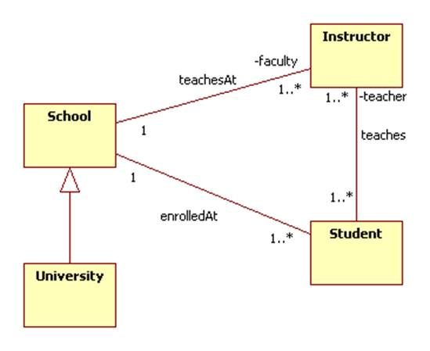

Slide 32
Recap - Domain Model Development
Process
Step 1. Perform a textual analysis of the problem specification for understanding the problem domain
Circle all nouns and underline the verbs
Step 2. Write down relevant domain entities. They are normally (some of) the nouns defined above.
Step 3. Revisit the specification to extract the associations
Step 4. Record associations with the corresponding domain entities.
Note: domain modeling is not design; it is merely a way to understand the abstract concepts relevant to the problem!
Notes:
This slide is taken from SDP… slightly modified!

Slide 33
“Exercise for the Reader”
Develop a domain model for a chess game that allows a human player to play a game of chess against a computer.
We may come back to this problem later in the semester…

Slide 34
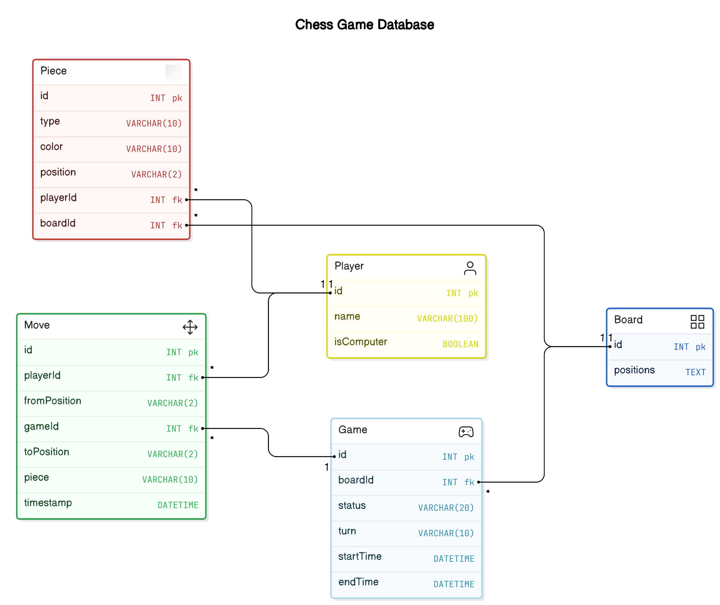

Slide 35
Software Design
The activity of software design can be seen as translating and refining a (problem) domain model into abstractions that can be directly mapped to an implementation in a programming language.
In general some “intermediate” steps will become necessary… solutions at different levels of abstraction
The “closer” the domain abstractions are to the target language, the easier this process will become…
Notes:
One can talk about domain-specific languages here…

Slide 36
Design Patterns are Abstractions
Design patterns document standard solutions to common (software) design problems:
“Each pattern systematically names, explains, and evaluates an important and recurring design in object-oriented systems. Our goal is to capture design experience in a form that people can use effectively.”
— Gamma et al., Design Patterns, 1995
We will cover Design Patterns in more detail in Lecture 7

Slide 37
Software Architecture
“In most successful software projects, the expert developers working on that project have a shared understanding of the system to be implemented. This shared understanding is called architecture and includes how the system is divided into processing elements (i.e. components) and their interaction through interfaces. Theses components are usually composed of smaller components, but the architecture only includes the ones that are understood by all developers.”
— Ralph Johnson, 2003
Notes:
Point out to ‘Who Needs an Architect’ paper of Martin Fowler!!

Slide 38
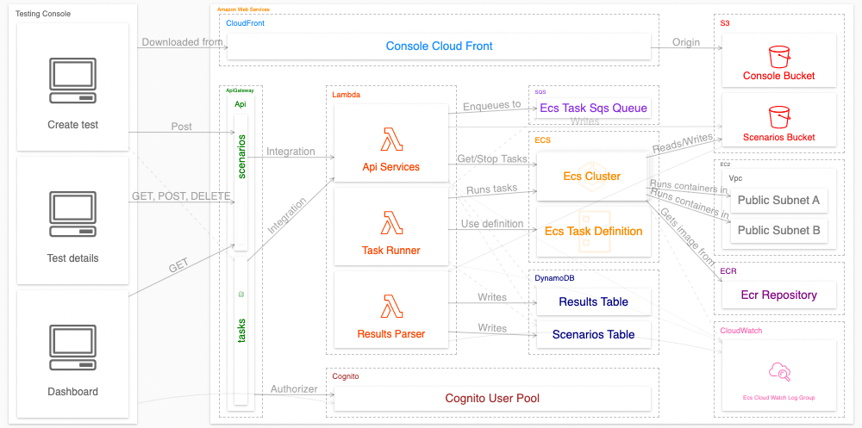

Slide 39
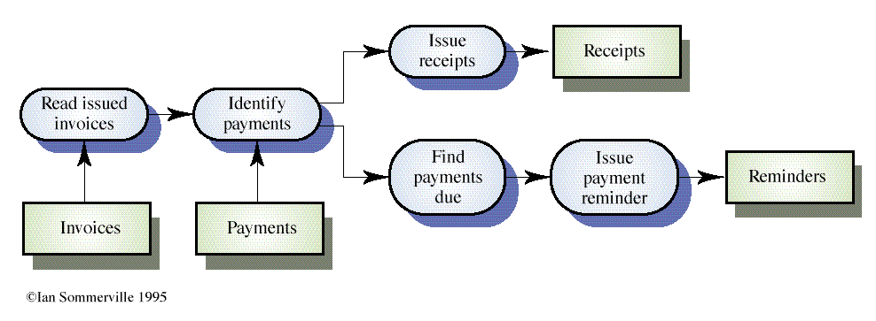
Example - Invoice Processing System

Slide 40
“Growing a Language”
‘‘A design is a plan how to build a thing. To design is to build a thing in one’s mind but not yet in the real world — or, better yet, to plan how the real thing can be built.’’
— Guy Steele, OOPSLA 1998

Slide 41
“Growing a Language” (cont.)
Keynote address at OOPSLA 1998 (Vancouver)
Main message: the importance of an appropriate vocabulary in communicating software design.
Lessons to be learnt: software designers need
a large vocabulary of design elements,
based on a small set of well-founded and well-understood principles,
experience when and how to use the vocabulary.
Abstraction is an important aspect of such a vocabulary!

Slide 42
Closing Remarks
Abstraction and modeling are used at every phase of the software development process.
The level, benefit, and value of a particular abstraction depend on its purpose.
Abstraction is key to mastering complexity in software systems.
Abstraction is key to decomposition.

Slide 43
Question for Consideration
Explain the relation between words, vocabulary and language, in the context of computer programming.
Explain why designing and implementing a small language that has limited functionality, but has the potential to grow, is a better alternative to developing a larger, more expressive language in the first place.
What is the difference between abstraction and modularity in a system and how can they be used to enhance the system?
Explain the analogy of Cathedrals, shopping malls and bazaars in relation to programming languages.

Slide 44
Question to Answer - Week 4
A good programmer in these times does not just write programs, he/she builds a working vocabulary. Provide examples and explain this statement.

Slide 45
Required Reading Lecture 5
Rebecca Wirfs-Brock and Alan McKean, Object Design: Roles, Responsibilitis, and Collaborations, Addison-Wesley, 2003, Chapter 1 (available from Google Books)
Timothy A. Budd, An Introduction to Object-Oriented Programming (3rd Edition), Addison-Wesley, 2002, Chapter 3 (available from Canvas)

